Slide 1
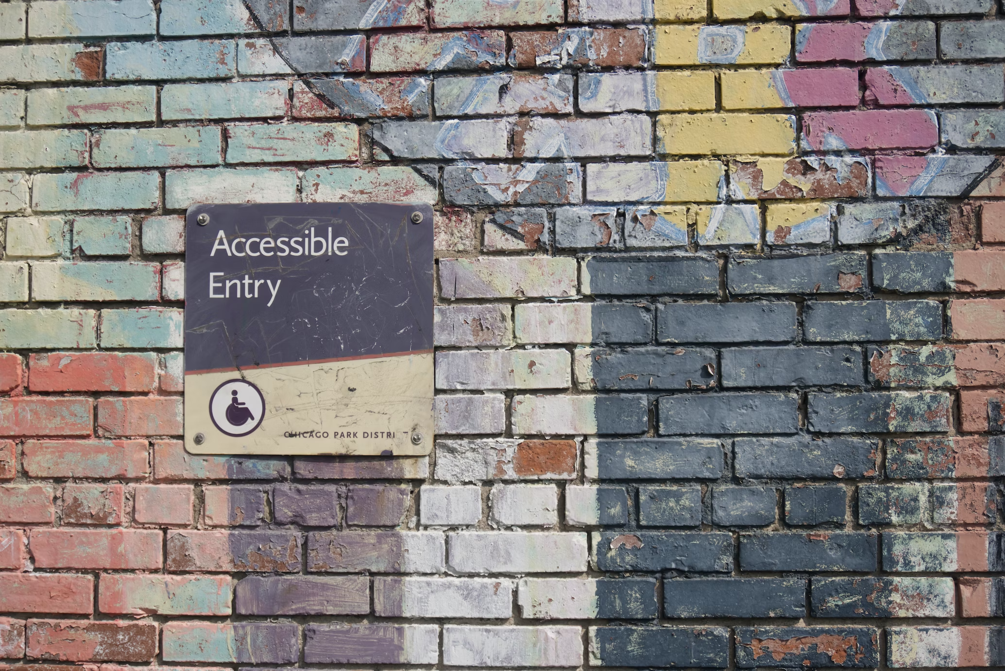
Accessibility
Notes:
Relevant sources:
- http://speakingjs.com/es5/ch18.html

Slide 2





Slide 3






About me
This is where I geek out on
Notes:
27 year, Amsterdam
Love gaming

Slide 4
What is accessibility?

Slide 5

What is accessibility?
Accessibility is the design of products, devices, services, vehicles, or environments so as to be
usable by people with disabilities. - Wikipedia
The fact of being able to be reached or obtained easily. -Dictionary

Slide 6
What reasons to use accessibility features?

Slide 7
What reasons to use accessibility features?
Vision: Blind / impaired vision / Broken computer screen

Slide 8
What reasons to use accessibility features?
Vision: Blind / impaired vision / Broken computer screen
Motion: Loss of limbs / Muscle impairment / Broken arm

Slide 9
What reasons to use accessibility features?
Vision: Blind / impaired vision / Broken computer screen
Motion: Loss of limbs / Muscle impairment / Broken arm
Auditory: Deafness / Tinnitus / broken speakers

Slide 10
What reasons to use accessibility features?
Vision: Blind / impaired vision / Broken computer screen
Motion: Loss of limbs / Muscle impairment / Broken arm
Auditory: Deafness / Tinnitus / broken speakers
Cognitive: Attention disorder / Dyslexia
Psychological / Medicinal / etc.
Conclusion: A lot of very diverse reasons!

Slide 11
Screen readers
For who? People with disabilities that have impaired vision Popular screenreaders
NVDA
JAWS
VoiceOver
ChromeVox

Slide 12
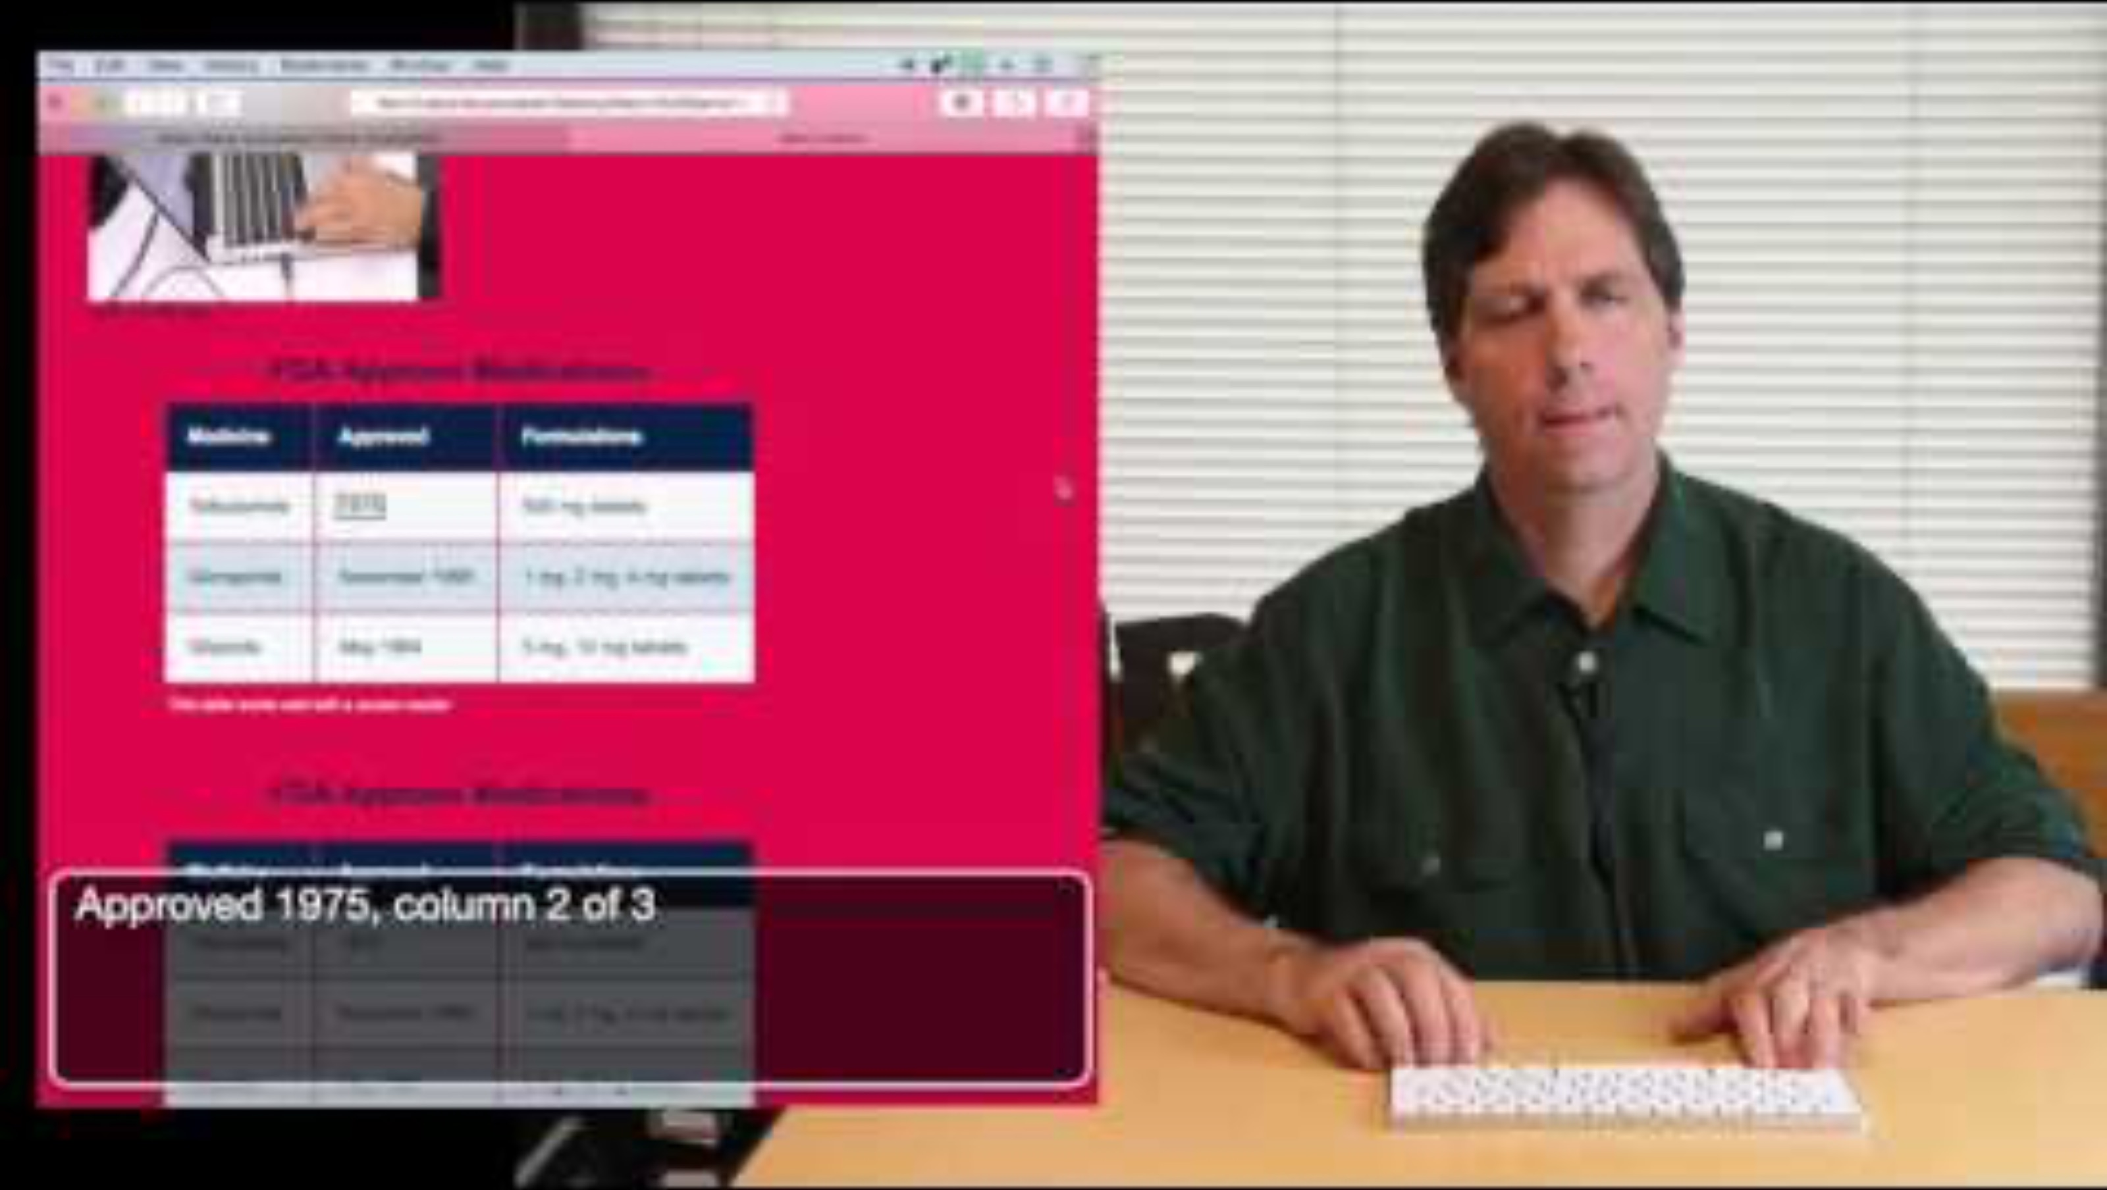
Accessible websites
What kinds of disabilities are there?

Slide 13

users

Slide 14
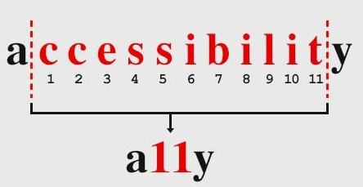
Theory on Accessibility What is Accessibility?
W3C
WCAG 2.0 Standards
Who is it for

Slide 15
W3 Standards Guidelines
Example: https://www.w3.org/WAI/standards-guidelines/wcag/
Use W3 to look up guidelines for

Slide 16
W3 Standards wCAG A, AA, AAA
Guidelines to indicate how accessible the website is you’re looking for
Example: https://www.toegankelijkheidsverklaring.nl/register

Slide 17
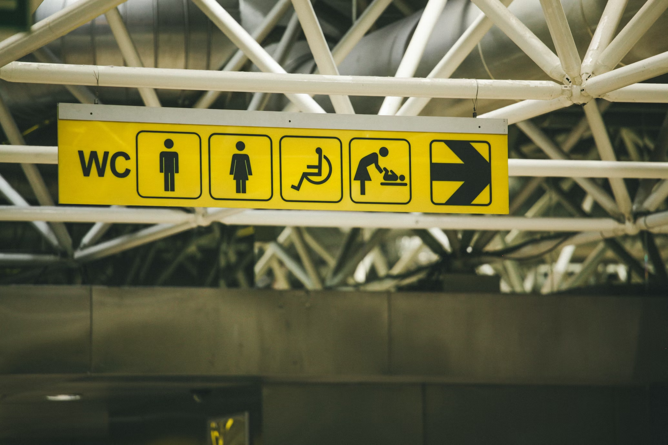
WCAG
Notes:
Relevant sources:
- http://speakingjs.com/es5/ch18.html

Slide 18

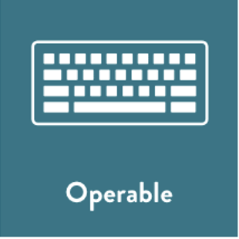


Four principles of WCAG Four principles
Perceivable
Can users perceive the content?
Operable
Can users use and navigate the application?
Understandable
Can users understand the application?
Robust
Can users use assistive technology in the application?

Slide 19

WCAG
Accessible
Code

Slide 20
Semantic HTML Semantic and non-semantic

Slide 21
Semantic HTML Semantic and non-semantic
Non-semantic HTML Tells nothing about the content
Semantic HTML Clearly defines its content
<header>
<nav>
1
2
<div>
<span>
<section>
<aside>
<section>
1
2
3
<form>
<table> <article>
<footer>

Slide 22
Semantic HTML Difference between semantic and non semantic html
1
2
3
4
5
6
7
8
9
10
11
<header></header>
<section>
<article>
<figure>
<img>
<figcaption></figcaption>
</figure>
</article>
</section>
<footer></footer>
1
2
3
4
5
6
7
8
9
10
11
12
<div id="header"></div>
<div class="section">
<div class="article">
<div class="figure">
<img>
<div class="figcaption"></div>
</div>
</div>
</div>
<div id="footer"></div>

Slide 23
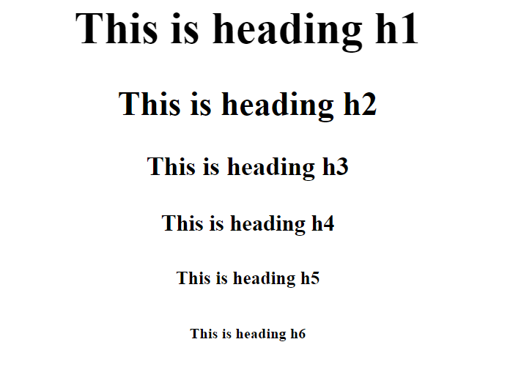
Semantic HTML Header tags

Slide 24
Section vs article Difference between section and article
Section
Thematic grouping of content
Typically has a heading
1
2
3
<section>
…
</section>
1
2
3
<article>…</article>
<article>…</article>
<article>…</article>

Slide 25
Buttons Aria-label and focus
Aria-label
Focus Do not remove the standard outline or add a focus
1
<button aria-label="Verwijder">
1
2
3
4
5
6
7
button {
outline: none;
}
button:focus {
background-color: grey;
}

Slide 26
Buttons Disabled and role attribute
Disable buttons if not focusable
When you do not want to focus a button use disabled
What if I can not use semantic HTML? Use the “role” attribute
But please dont do this!
1
<button disabled>
1
2
3
4
<div role="button" tabindex="0">
Continue
</div>

Slide 27
Skiplinks Skiplinks on a webpage

Slide 28
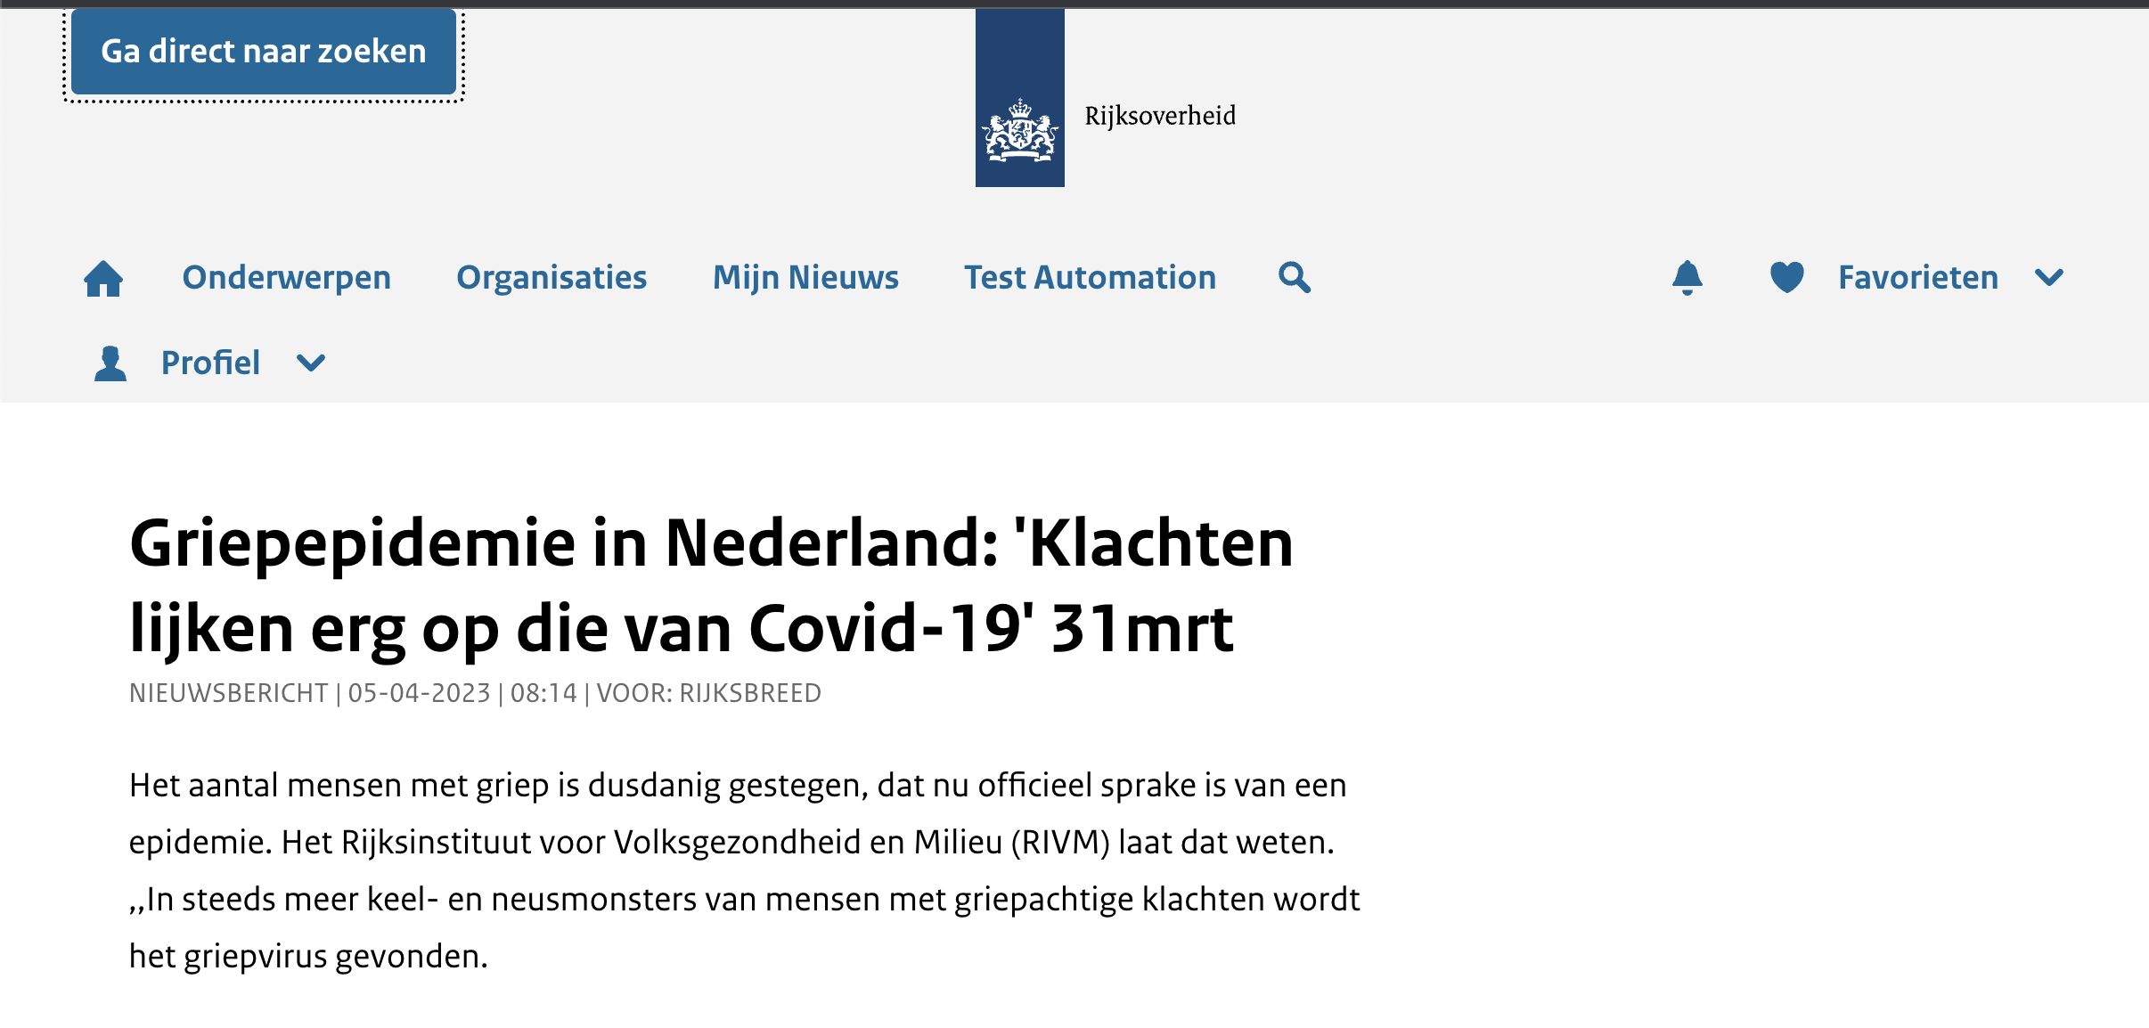
Skiplinks Skiplinks on a webpage
Keyboard-only users have trouble navigating through a large navigation.
The solution is to implement a skiplink to navigate directly to the main content

Slide 29
Alt text attribute Images
For users that have impaired vision having an alt tekst will aloow them to know what the image is.
Decorative images should get an alt tag, but empty.
But why?
EXAMPLE: https://developer.mozilla.org/en-US/docs/Web/HTML/Element/img
1
<img src="img_apple.jpg" alt=”Image of an apple">

Slide 30

AriA roles

Slide 31
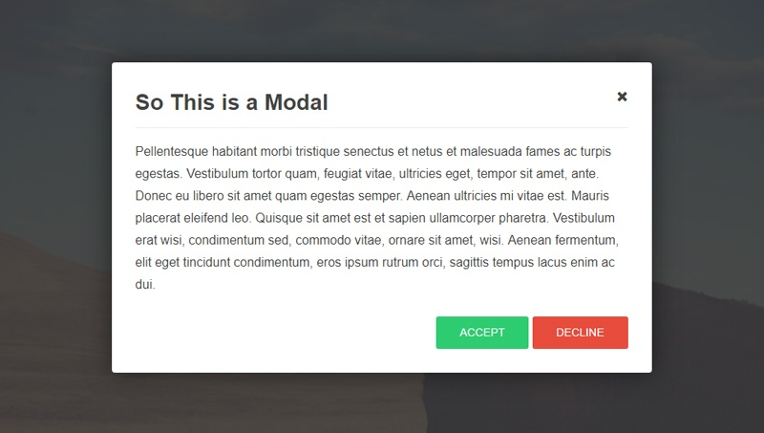
Aria roles Role attribute
Keyboard-only users have trouble navigating through a large navigation. The solution is to implement a skiplink to navigate directly to the main content. EXAMPLE: https://developer.mozilla.org/en-US/docs/Web/Accessibility/ARIA/Roles

Slide 32
Alert Alert users
Sometimes when you want to notify users you will need to alert the ones you can not see.
EXAMPLE: https://developer.mozilla.org/en-US/docs/Web/Accessibility/ARIA/Roles/alert_role
1
2
3
<div id="expirationWarning" role="alert">
<span class="hidden">Your log in session will expire in 2 minutes</span>
</div>

Slide 33
Aria-live Assertive vs polite vs off
Assertive Indicates that updates to the region have the highest priority and should be presented to the user immediately. Avoid using this
Polite Indicates that updates to the region should be presented at the next graceful opportunity, such as at the end of speaking the current sentence or when the user pauses typing.
Off Indicates that updates to the region should not be presented to the user unless the user is currently focused on that region.

Slide 34
Aria-live
1
<div id="announce-when-ready" aria-live="polite"> … </div>
1
<div id="announce-immediately" aria-live=”assertive"> … </div>
1
<div id="announce-when-focused" aria-live=”off"> … </div>

Slide 35
Let’s Test our knowledge
https://www.lingscars.com/
https://www.w3.org/WAI/demos/bad/after/home.html

Slide 36
Stop using Top, bottom, left and right
Margin-left
Margin-right
Margin-top
Margin-bottom
https://medium.com/@kellycochrane2/why-you-should-stop-using-traditional-margin-and-padding-when-styling-with-css-21428c3ee7

Slide 37
Stop using Top, bottom, left and right
Left to right
Right to left
margin-right: 1rem;
margin-inline-end:
1rem;
https://medium.com/@kellycochrane2/why-you-should-stop-using-traditional-margin-and-padding-when-styling-with-css-21428c3ee7

Slide 38

Stop using Top, bottom, left and right
Left to right
Right to left
1rem
margin-right: 1rem;
1rem
margin-inline-end:
1rem;
https://medium.com/@kellycochrane2/why-you-should-stop-using-traditional-margin-and-padding-when-styling-with-css-21428c3ee7

Slide 39


Stop using Top, bottom, left and right
Left to right
Right to left
1rem
1rem
margin-right: 1rem;
1rem
1rem
margin-inline-end:
1rem;
https://medium.com/@kellycochrane2/why-you-should-stop-using-traditional-margin-and-padding-when-styling-with-css-21428c3ee7

Slide 40
Stop using Top, bottom, left and right
Margin-left --> margin-inline-start
Margin-right --> margin-inline-end
Margin-top --> margin-block-start
Margin-bottom --> margin-block-end
https://medium.com/@kellycochrane2/why-you-should-stop-using-traditional-margin-and-padding-when-styling-with-css-21428c3ee7

Slide 41
Accessibility Checklist
Use native elements
Consult the w3c website
Use tools, but don’t blindly trust them
Think for and outside yourself

Slide 42

Exercises

Slide 43
Axe DevTools Exercise
Install Axe DevTools
Use it on your assignment
Try to remove as many problems as you can
Reach level WCAG AA (according to Axe DevTools)

Slide 44
Screen readers Exercise
Use a screen reader to navigate through the codepen and try to find out how the screen reader behaves
Use the screen reader on the website you have picked before and find out what can be improved
EXAMPLE: https://codepen.io/adamjohnson/pen/BaJdYeE

Slide 45
About Capgemini Academy
Developed by Capgemini Academy DCX Front-end Cluster
Capgemini is a global leader in partnering with companies to transform and manage their business by harnessing the power of technology. The Group is guided everyday by its purpose of unleashing human energy through technology for an inclusive and sustainable future. It is a responsible and diverse organization of over 300,000 team members in nearly 50 countries. With its strong 50-year heritage and deep industry expertise, Capgemini is trusted by its clients to address the entire breadth of their business needs, from strategy and design to operations, fuelled by the fast evolving and innovative world of cloud, data, AI, connectivity, software, digital engineering and platforms. The Group reported in 2020 global revenues of €16 billion.
Get The Future You Want | academy.capgemini.nl

